Slide 1

We offer solutions that
raise your life above the expected

Slide 2
Agenda
Who we are?
Why are we here ?
Why this ?
How it works ?
Contact

Slide 3
Variablez !!!!

Slide 4
We have resources, we have brains so
why not use them

Slide 5
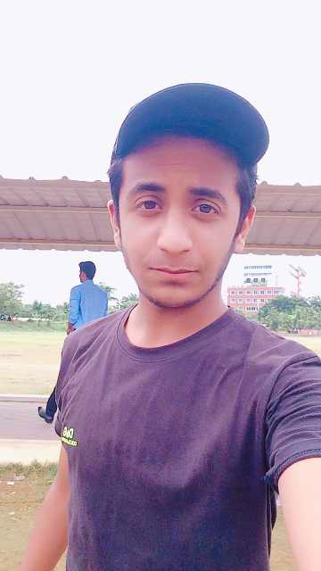

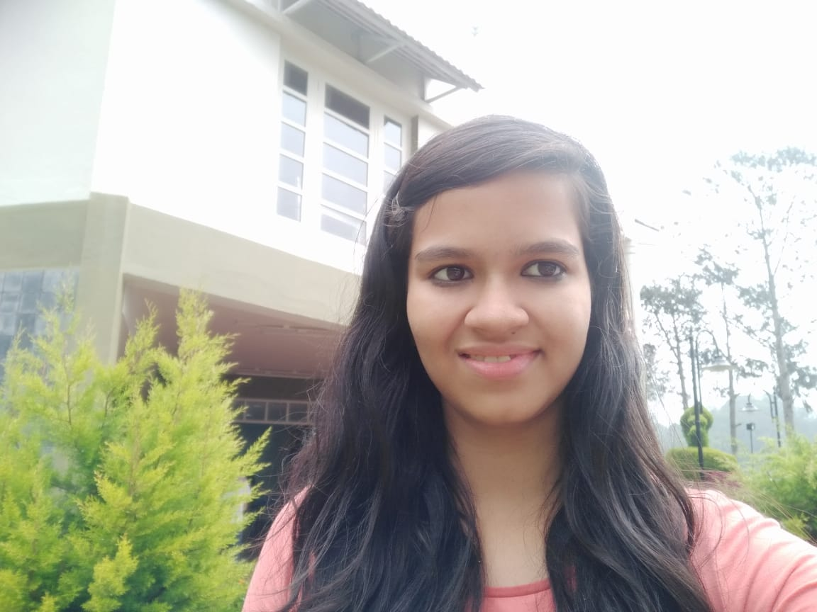
Who are we ?
Sundar. A
III year B.Tech(ECM), VIT University.
Rohan Luthra
III year B.tech(ECM), VIT University.
Jay Patel
III year B.tech(ECM), VIT University.
Mridhula K
III year B.tech(ECM), VIT University.

Slide 6
We are Variables because we are simply not constants. We are the varying people who go round learning and doing stuffs with the modern technologies in this fast growing world.

Slide 7
What’s on
Our mind?

Slide 8
You can run but can’t escape

Slide 9
So here is our
Networking Smart Security

Slide 10
Real time needs
Cost efficient
Power efficient
Performance efficient
Automated
Backup

Slide 11
When you can track, why just watch

Slide 12
What does this do ?
Personal home:
Gives remote access of the locks to the user
User can see the persons who want to enter their house
Get the details of the person using face recognition
Make decisions on the same
Public sector:
Criminal detection and tracking
If the criminal even gets out of the range of one camera, he will fall into the range of another camera. Hence criminals can be tracked indirectly
Optimized image clicking intervals

Slide 13



Things getting smarter
Welcome to AI
Learn
and seek
Wireless Connectivity
Seamless management
Cloud Computing
Spiking CNN
IoT
AWS
Sage maker
Raspberry Pi & Android

Slide 14
Work Flow
Welcome to AI
AWS
Serverless
NoSQL
Neural networks platform
Raspberry Pi
LCD
Camera
IR sensor
Android
Advanced JAVA
Map box SDK
AWS SDK & XML

Slide 15
Why cloud ?
Reliability
Availability
Security
There are more possibilities of a server to break down
So for critical usages and minimal cost, Clouds stands has the best fit option

Slide 16
Spiking Neural Networks
We can learn the potential sensitive points
Most advanced neural network
Its runs based on spikes with high speed and explicitly tremendous security
Image recognition
We used support vector machines algorithm to do the image recognition.

Slide 17
Spiking CNN
Implementation

Slide 18
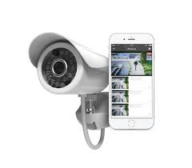
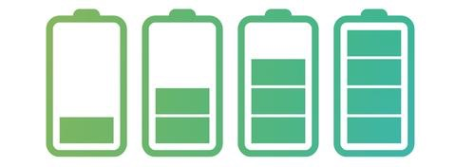
Power efficiency
Implementation

Slide 19
IoT
We can learn the potential sensitive points
Raspberry Pi
IOT is used as a gateway for the future world
Python
98%
Linux
75%
Android
Let the users play the game
Advanced JAVA
80%
UI
100%

Slide 20
Seamless
Automation
Multiple devices can be integrated together and be monitored by a central organization.
The whole process can be automated.
Wireless
The whole communication is wireless and can be accessed from anywhere across the world.
Efficiency
Back Up History
We can use lesser power as we optimally determine the time of a click.
Battery life and other history can be calculated.
There are a few advantages of the Smart system.

Slide 21
Advantage
08
AI vs non AI
AI
Higher peaks of accuracy – Hence more precise recognition
Centralized control of all the devices
AI
Complication of the things by manual activities
No facility to do analytics
AI enabled vs Regular system
This is a comparison between AI enabled and non AI systems.

Slide 22
Design Implementation
03 Android
01 Learning
Get into the ocean of wireless and access all over the world.
Learn the facial patterns of the people.
02 Recognizing
04 Control from anywhere
Here’s where we play the actual game.
Using the peaks of IOT, anything is possible
We can see the design implementation in the following videos.

Slide 23
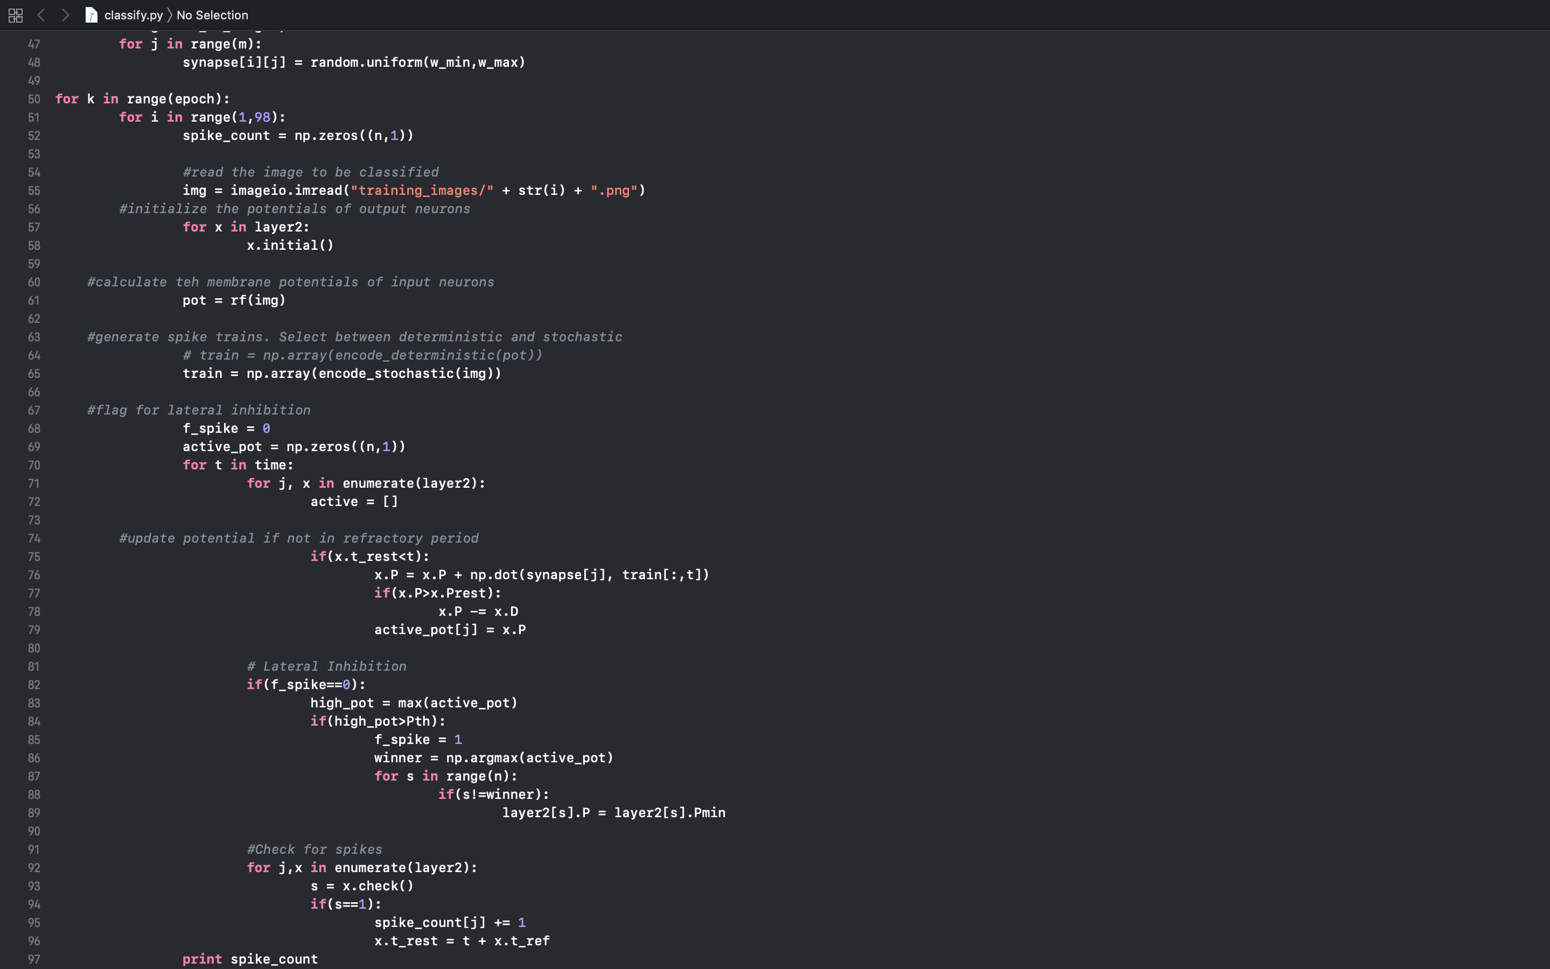
Software Implementation
Implementation

Slide 24
Real time needs
Cost efficient
Power efficient
Performance efficient
Automated
Backup

Slide 25
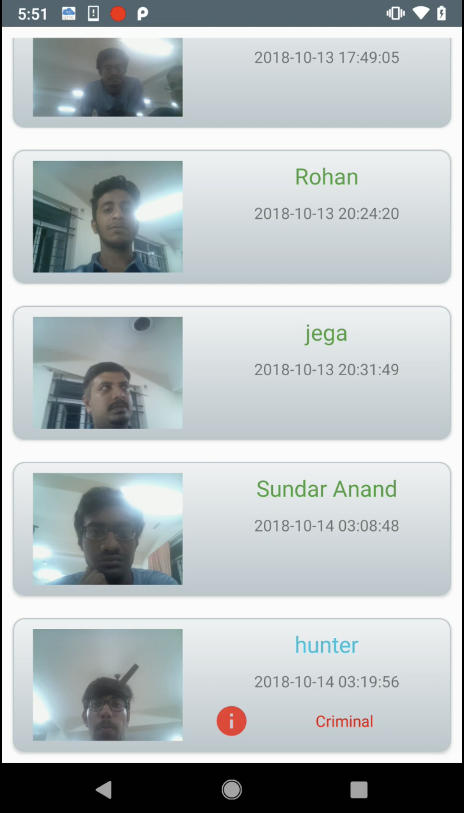
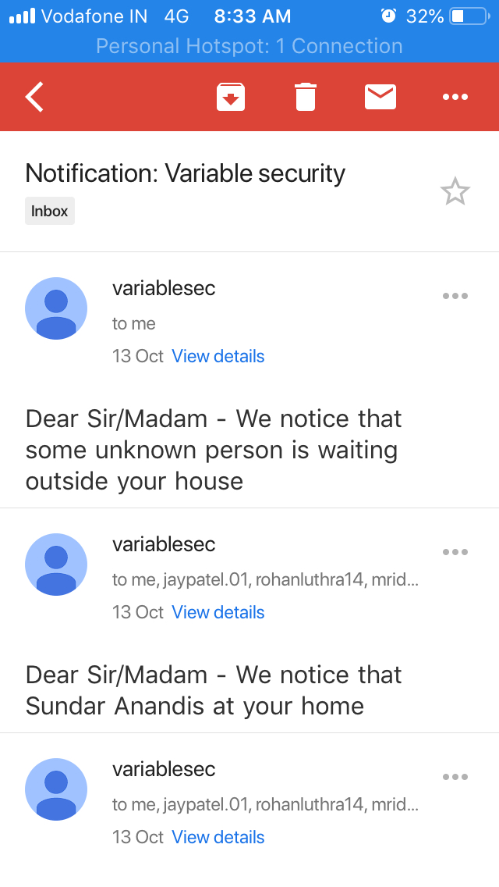
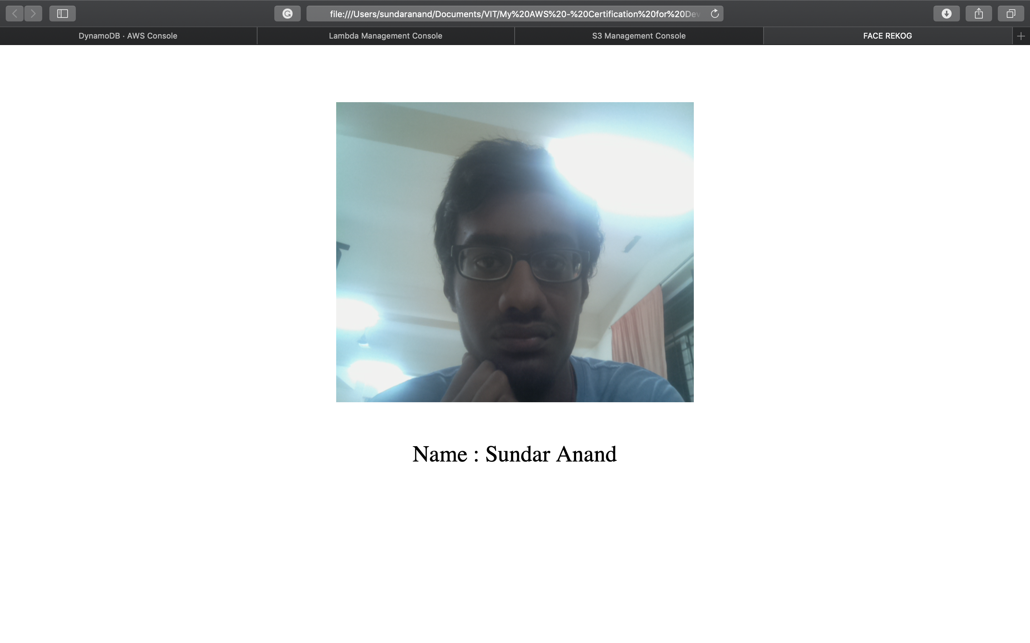
Output screenshots
Implementation

Slide 26
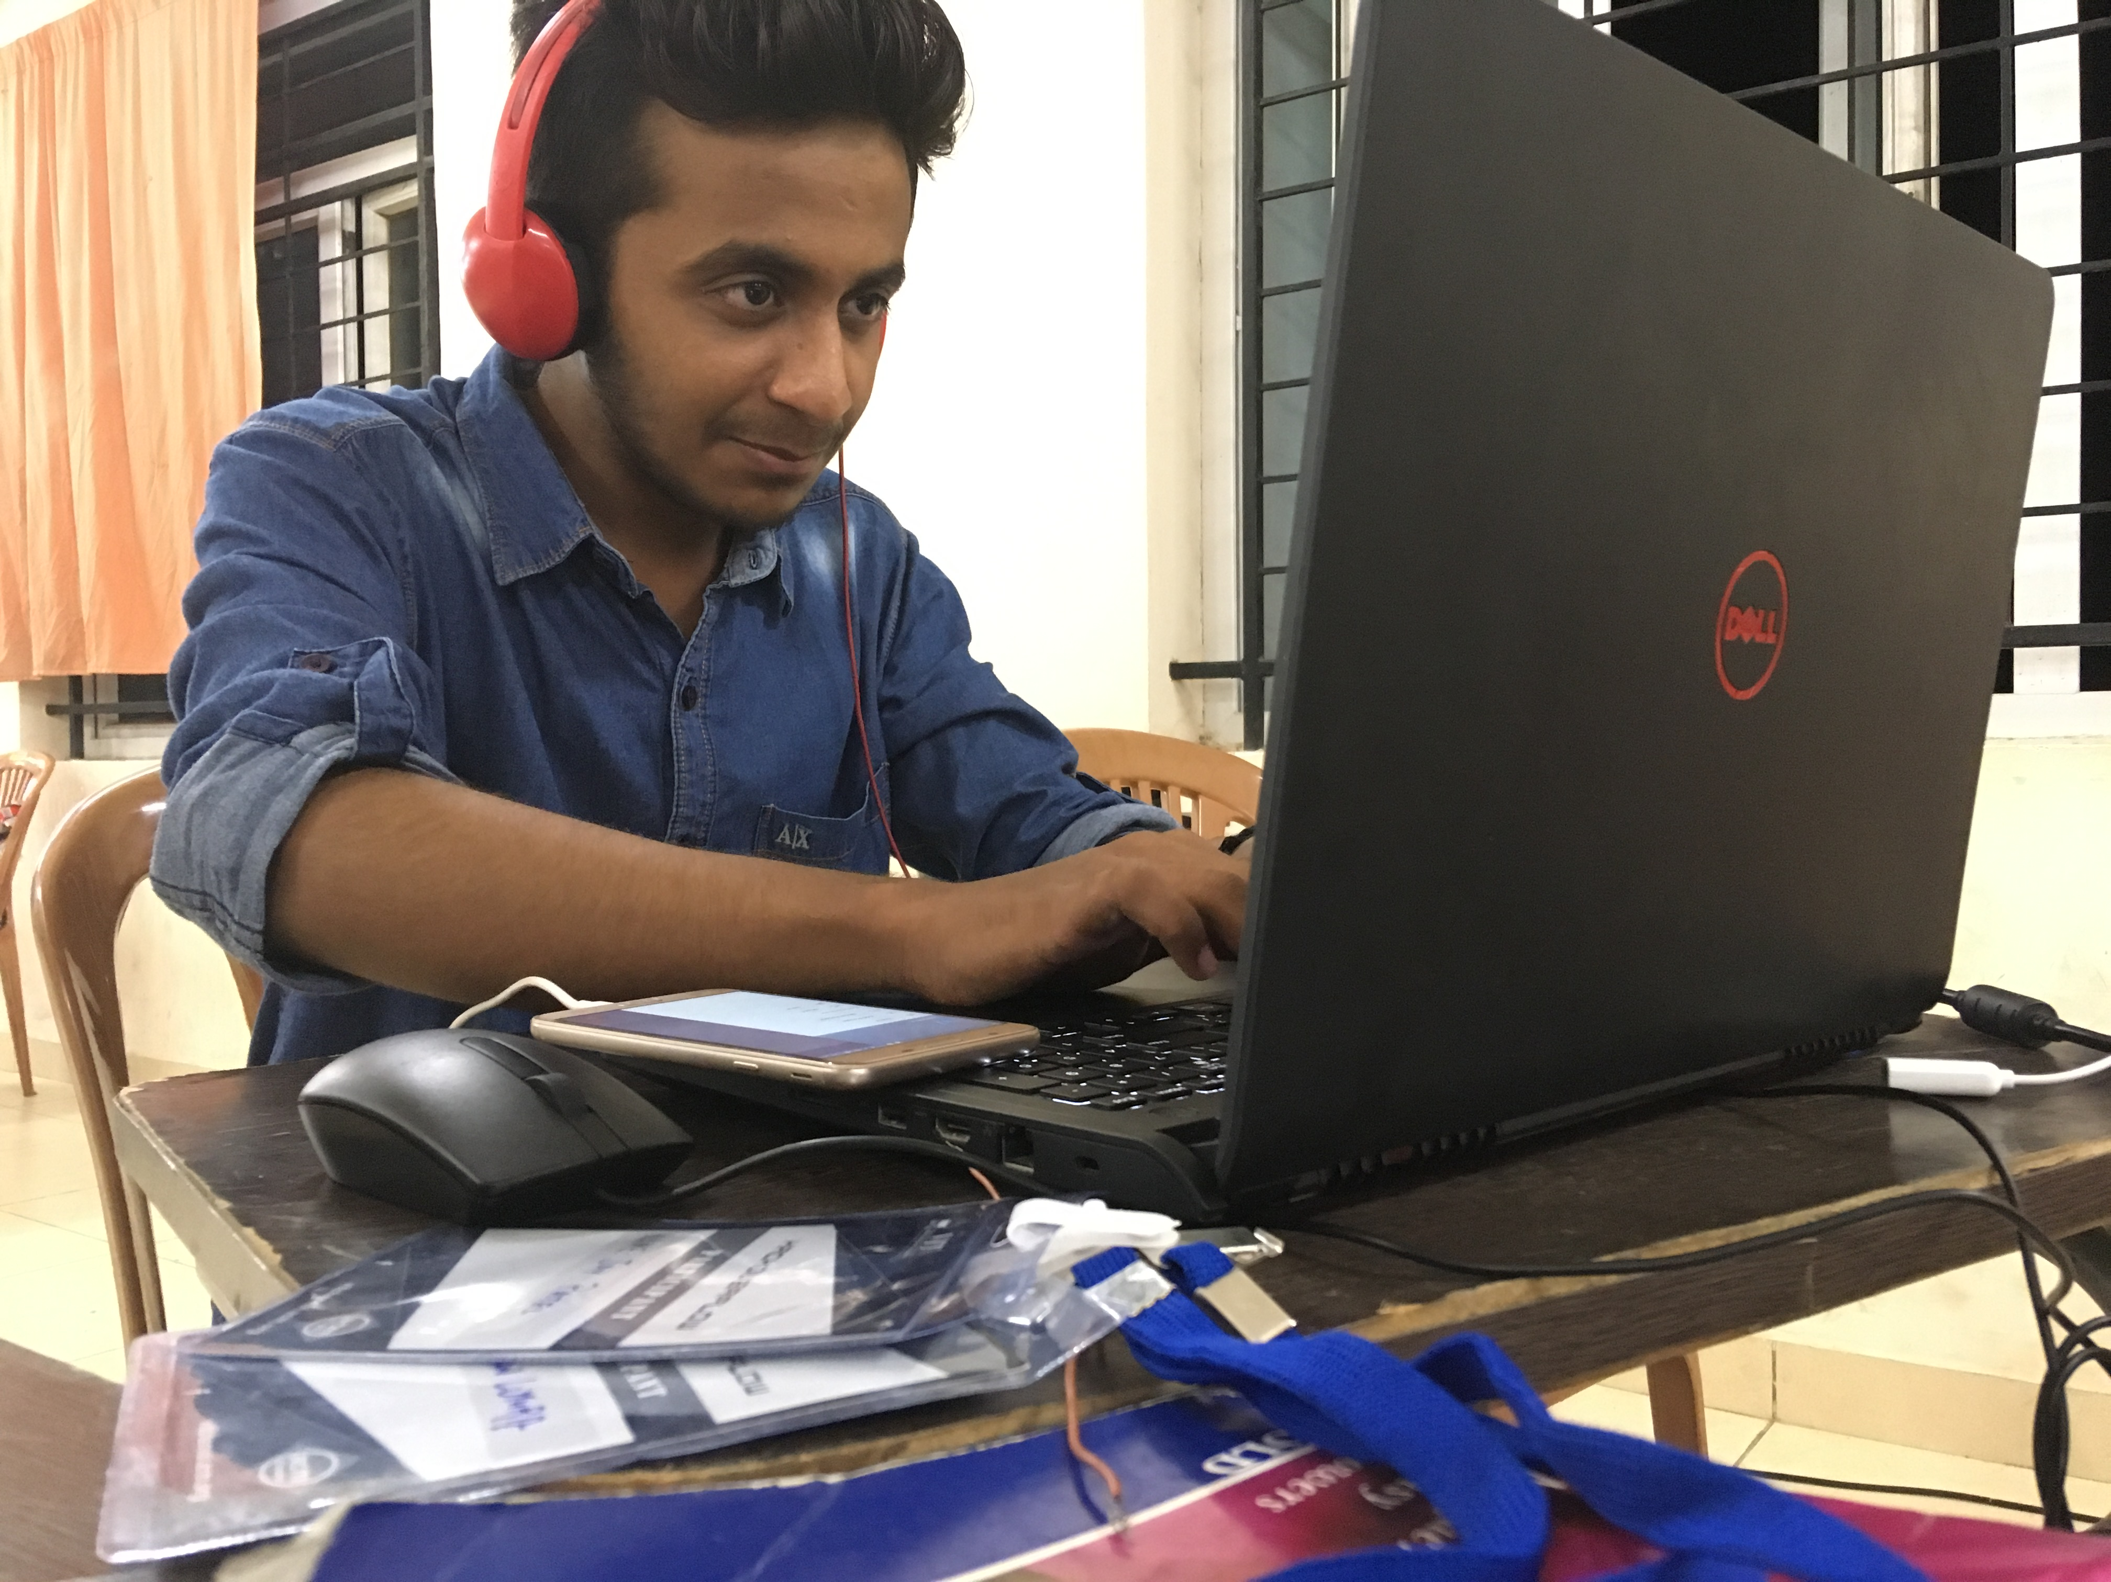
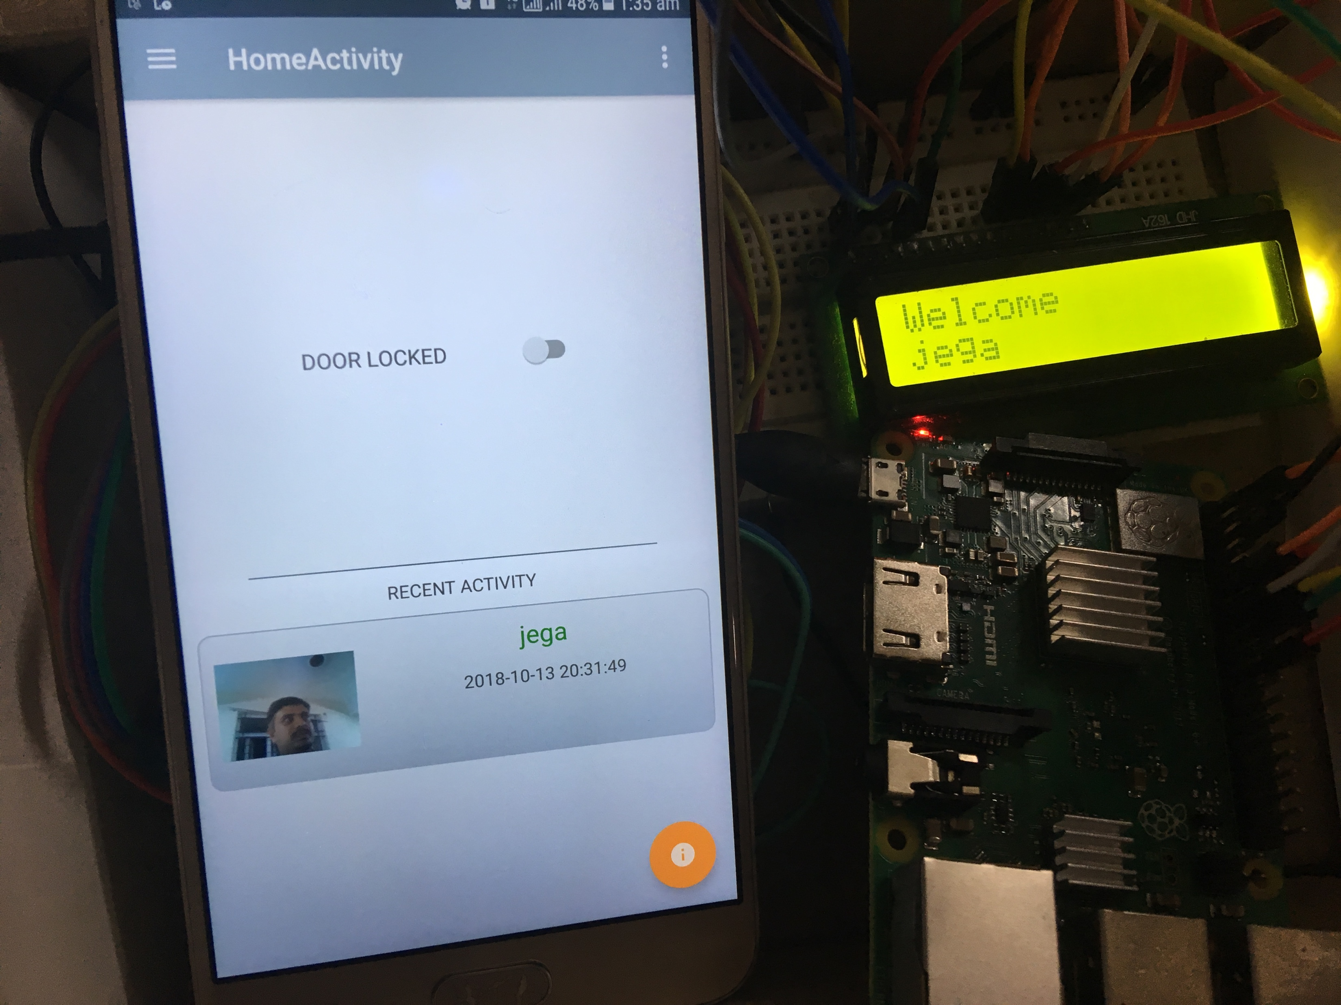
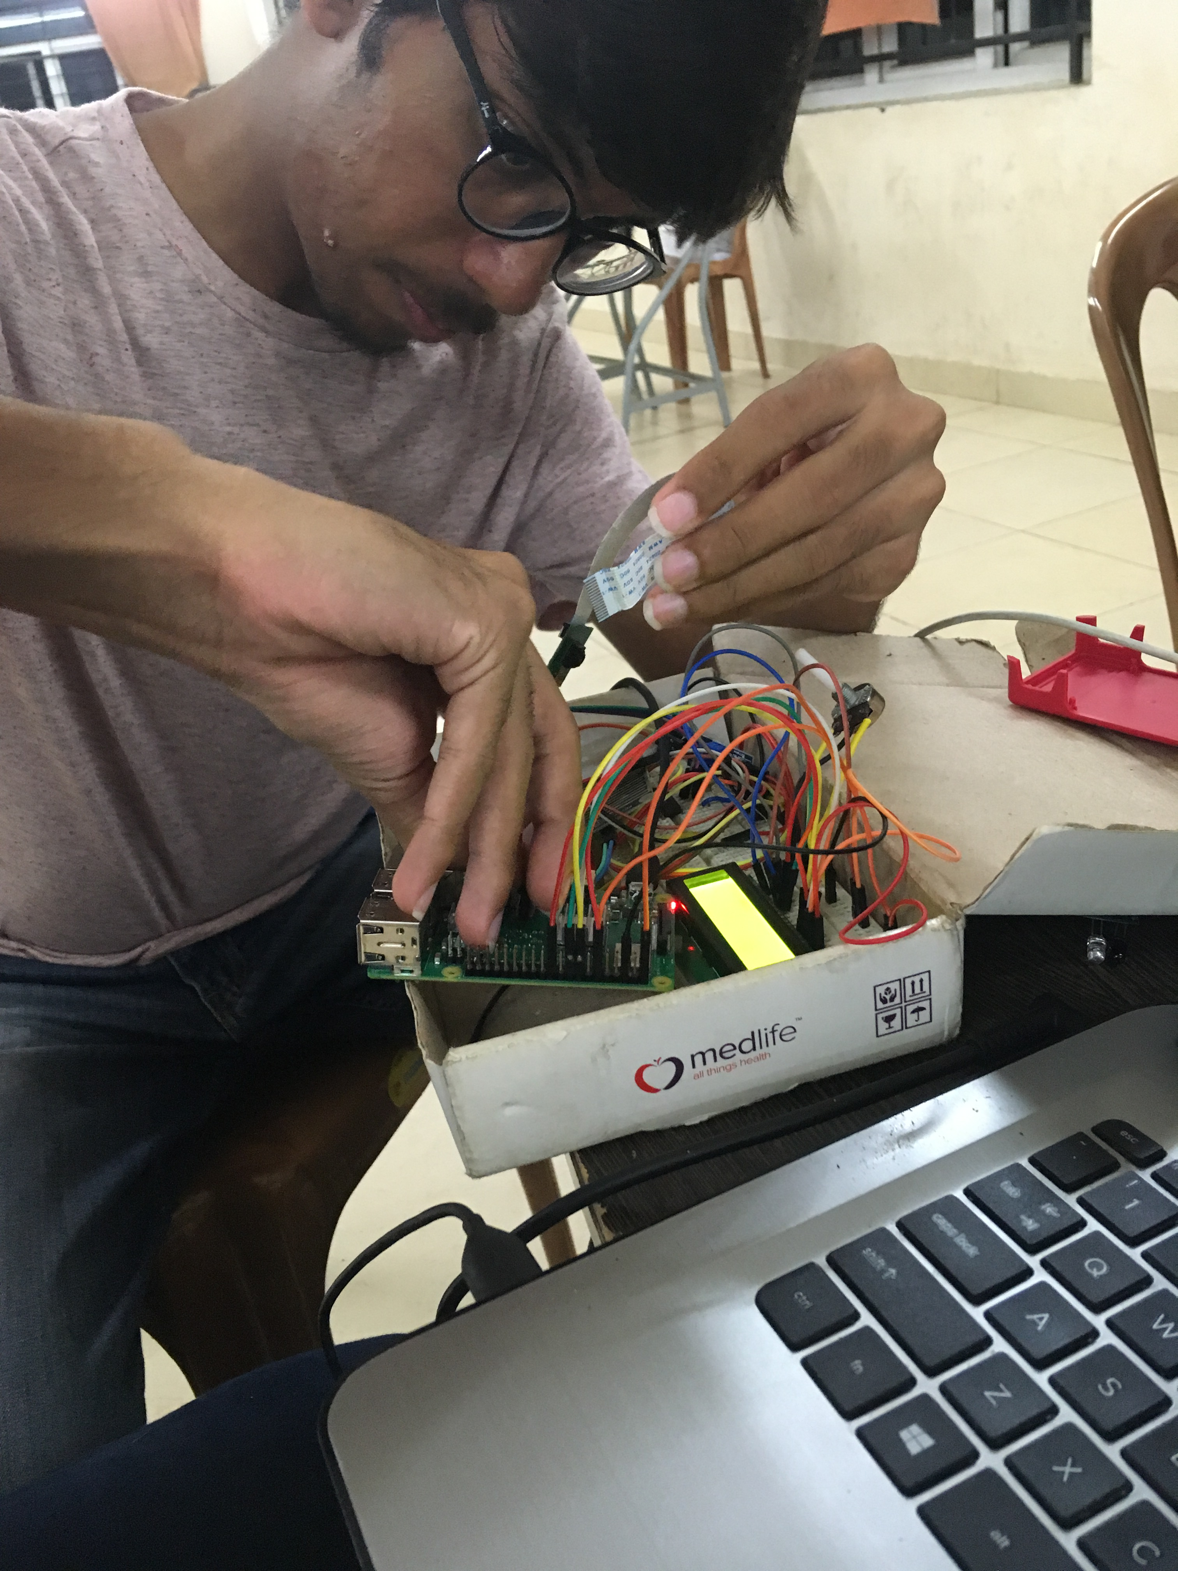
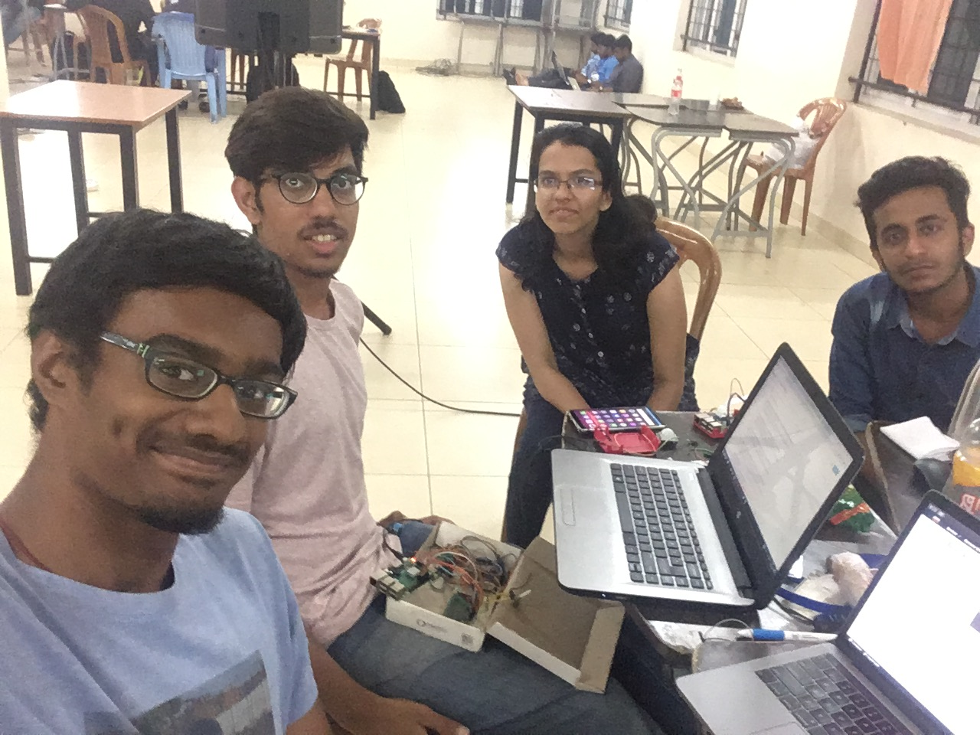
Our Team

Slide 27
Fell free to say hi! We are friendly and social
VIT UNIVERSITY
SENSE SCHOOL
CHENNAI

